Slide 1
Introduction
Welcome

Slide 3
How to View This Presentation
To switch to Notes Page view:
While in edit mode, click the View tab within the ribbon, and then click Notes Page
To navigate through notes, use the Page Up and Page Down keys
Zoom in or zoom out, if required
In the Notes Page view, you can:
Read any supporting text—now or after the delivery
Add notes to your copy of the presentation, if required
Take the presentation files home with you

Slide 4
Let’s get started
Introduction
Logistics and Schedule
Topics
Objectives
Content
Labs

Slide 5
Introduction
Who am I?
Name
Region
Premier Field Engineer in SharePoint and Development at Microsoft
Who are you?
Name, company affiliation and role
Experience with SharePoint
Expectations for this workshop
Notes:
Introduce yourself to your audience and do a round amongst your students to get to know their background, skill level and hear their expectations for the workshop

Slide 6
Logistics and Schedule
Hours
Restrooms
Meals
Devices
Notes:
Also:
Parking and transport
Smoking locations
Recycling

Slide 7
Workshop Topics
Introduction
SharePoint APIs
SharePoint Add-Ins
SharePoint Framework
Branding and customization
Events
Notes:
* = includes hands-on lab

Slide 8
Workshop Objectives
After completing this workshop, you will
Understand your options for developing against SharePoint
Know how to work with events
Understand the SharePoint Add-In & SPFx Models
Be introduced to frameworks which give you a head start in developing your own customizations
Notes:
After having gone through all of the topics shown on the previous slides, we hope to have accomplished the workshop objectives shown on this slide

Slide 9
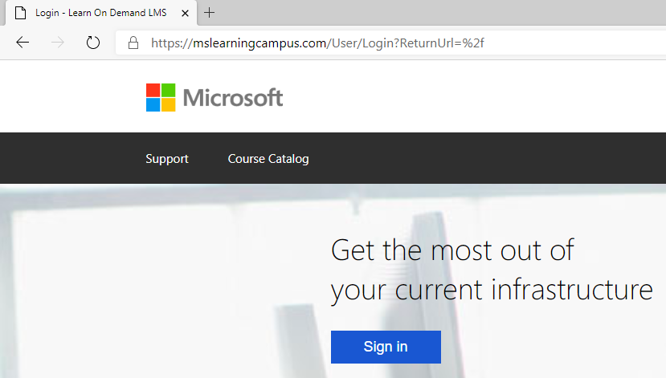
Cloud Hosted Labs
Browse to https://aka.ms/lod
Click on Sign in

Slide 10
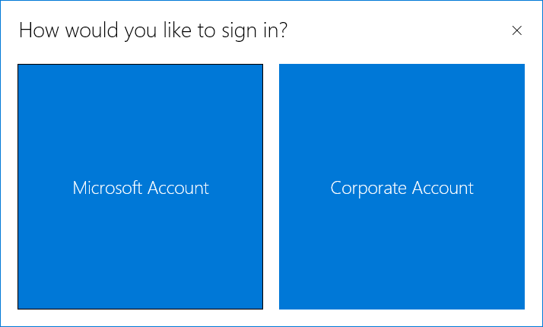
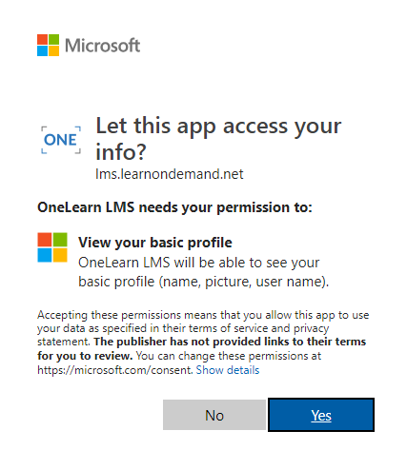
Cloud Hosted Labs
Log in with either your own Microsoft Account or your corporate work account
Consent to the trust dialog
Notes:
Students can log onto the LOD environment using their personal Microsoft Account, their corporate account from any Azure Active Directory or if both are problematic, you could create a student account for them in the temporary Office 365 Tenant provisioned with your own instructor LOD instance and have them log on with those credentials.

Slide 11
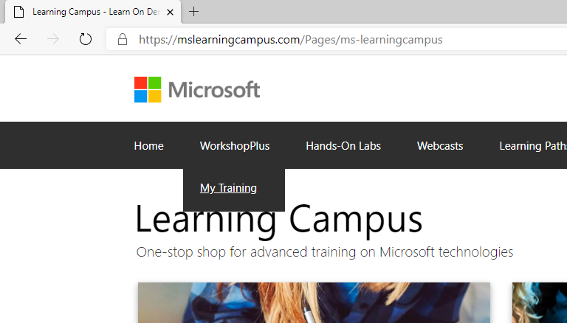
Cloud Hosted Labs
Under WorkshopPlus go to My Training

Slide 12
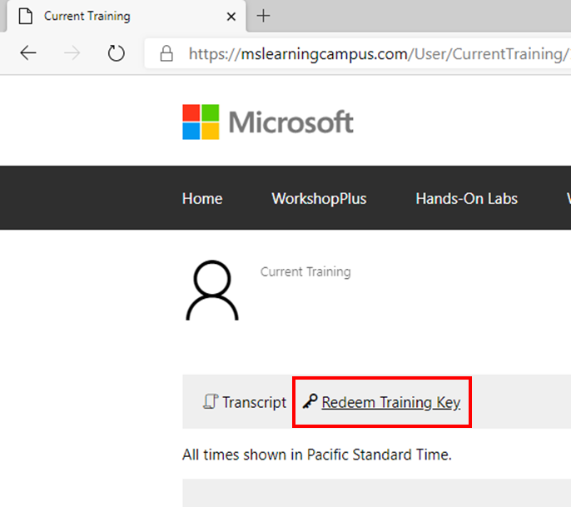
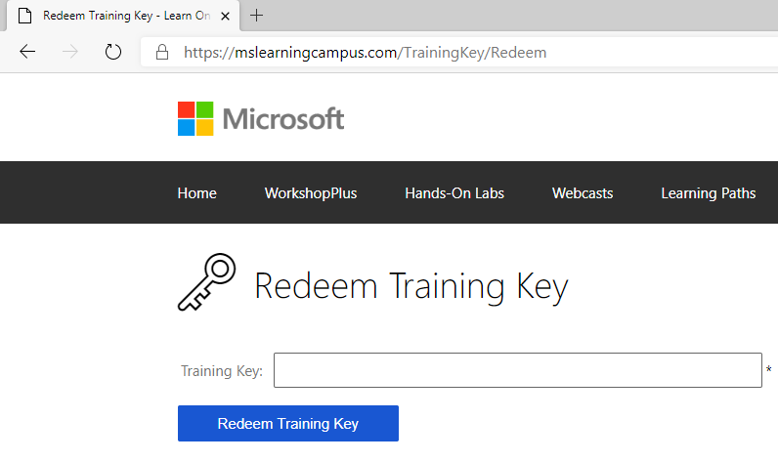
Cloud Hosted Labs
Click on Redeem Training Key
Enter training key:
…
Notes:
Trainer: add training code in the rectangular box. You should have received this key by e-mail a few days prior to your workshop or you can find it back in LOD under My Classes.

Slide 13
Cloud Hosted Labs
Click on Launch Lab
Notes:
Ask your students to launch their virtual environments already. This may take a few minutes to complete. Meanwhile you continue with the next slides where you will demonstrate the environment. By the time you end your demonstration, their environments should be up and running and they can continue preparing their environments through the lab exercise

Slide 14
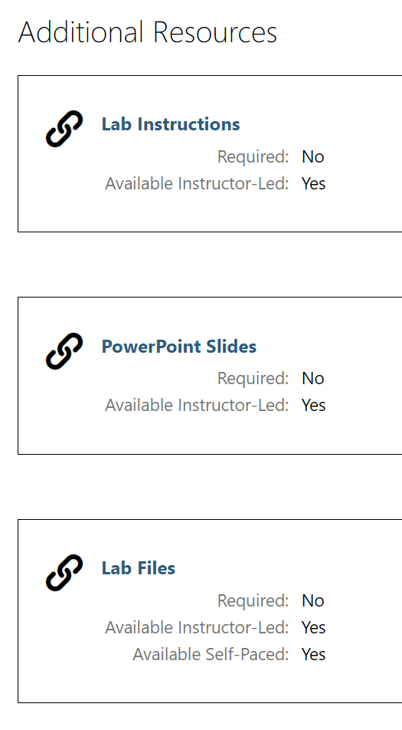
Content
PowerPoint presentations
Lab documents
Lab files
Other samples that come up this week
Notes:
The PowerPoint slides, lab documents and lab files can be downloaded by the students themselves from the Learn On Demand environment while the workshop is running.
Other samples or content you may want to share with your customers, you need to find a way yourself to transfer this across. I.e. a shared Microsoft Teams team, share through OneDrive for Business, send through e-mail, etc.

Slide 15
Labs
Each lab environment has two VMs running
Domain Controller (DC)
Log in using contosoltd\student
All user accounts have the password Pass@word1
Student Machine (SPDEV2019)
Log in using contosoltd\administrator
Windows 2016, SharePoint Server 2019/SQL 2016/SharePoint Designer 2013/Visual Studio 2017 & 2019
Windows 2016
Notes:
Always show this section, regardless whether using cloud or locally hosted labs as both of the environments are the same

Slide 16
Demo
The lab environment
Notes:
Show how to connect to the SPDEV2019 machine
Start Internet Explorer
Show how the favorites bar gives easy access to all lab site collections
Go to the Search Center and execute a search for “SharePoint” to show that it is a fully functional SharePoint environment
Start Visual Studio
Explain the first steps of choosing a theme and such to get started
Open the Tools folder on the desktop
Briefly explain each of the tools in there and what they can be used for
Open SharePoint Designer
Show how to choose the first option in the updates dialog
Show how to connect to https://dev.contoso.local
Open C:\Students
Explain that this folder contains all lab materials
Explain the structure of the folders: each lab has its own folder, the PDF and DOCX therein have the same contents, the Resources subfolder has files that are needed to complete the labs, the Solution subfolder contains the completed solution in case you get stuck and want to compare what is different

Slide 17
Lab: Preparing your lab environment
In this lab, you will prepare your Learn On Demand lab environment. This environment is only for yourself and will be used throughout the remainder of the workshop to gain hands on experience with the various topics lectured in this workshop.
Time estimation: 10 minutes

Slide 18
Questions

